Slide 1



Data Modelling in Databases & Data Warehouses
(A Brief Introduction)
Dr. Ehibhahiemen Nelson Ughele

Slide 2

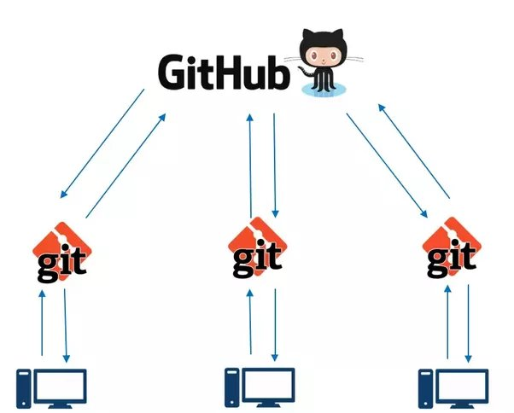
GIT AND GITHUB

Slide 3
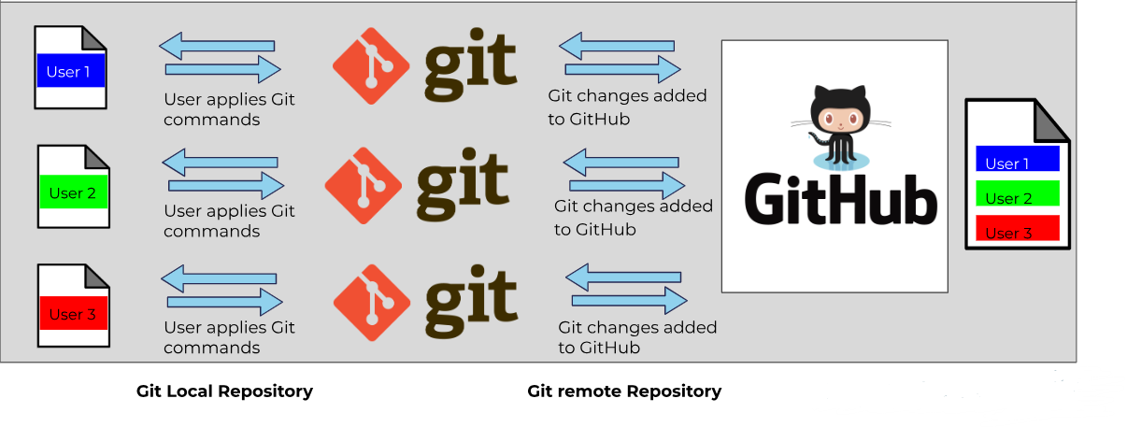
Introduction: What is Git?
Here is summary of how different users interact with GitHub through Git:

Slide 4
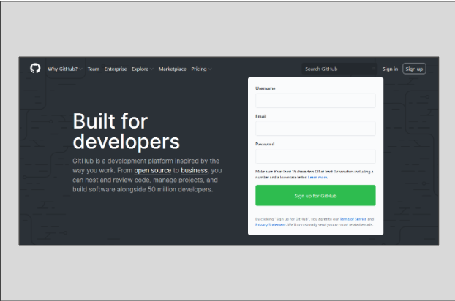
Getting started with GitHub: Creating GitHub Account
Let's start by creating a GitHub account. Here's how:
Step 1: Follow this link to begin setting up your GitHub account.
Step 2: Fill in your information and move forward with the verification process, opting for the free plan.

Slide 5
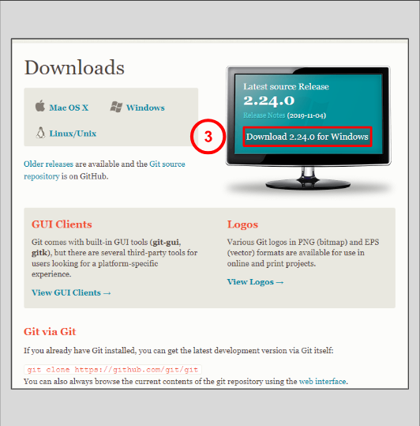
Setting up Git on Windows: Installing Git
For macOS users, please proceed to the specified link.
Step 3: Windows users can download the appropriate version by visiting this link.

Slide 6
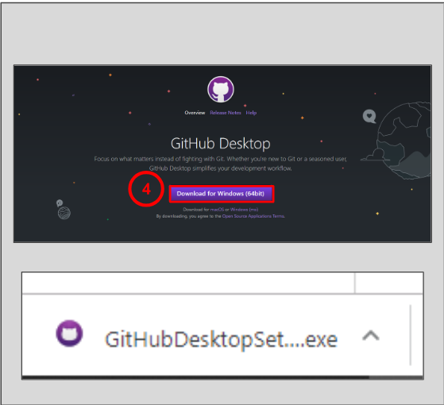
Setting up Git on Windows: Downloading GitHub for Desktop
Step 4: Navigate to the provided link to download GitHub Desktop.
Step 5: Launch and execute the downloaded .exe file to start the installation of the desktop application.

Slide 7
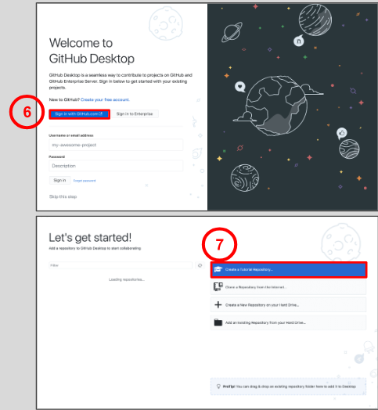
Setting up Git on Windows: Downloading GitHub for Desktop
Step 6: Log in to GitHub using the same email address you registered with.
Step 7: Feel free to create a tutorial repository to deepen your understanding of GitHub's functionalities.

Slide 8
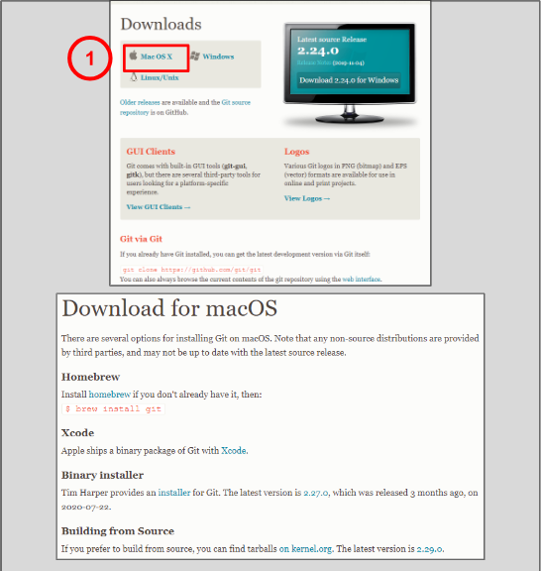
Setting up Git and GitHub: macOS
For Windows head here
Step 1: Visit the provided link to access multiple methods for installing Git on macOS. Select the installation method that best suits your preferences.
Step 2: Utilize this link and this link to guide you through configuring Git and GitHub on your macOS system.

Slide 9
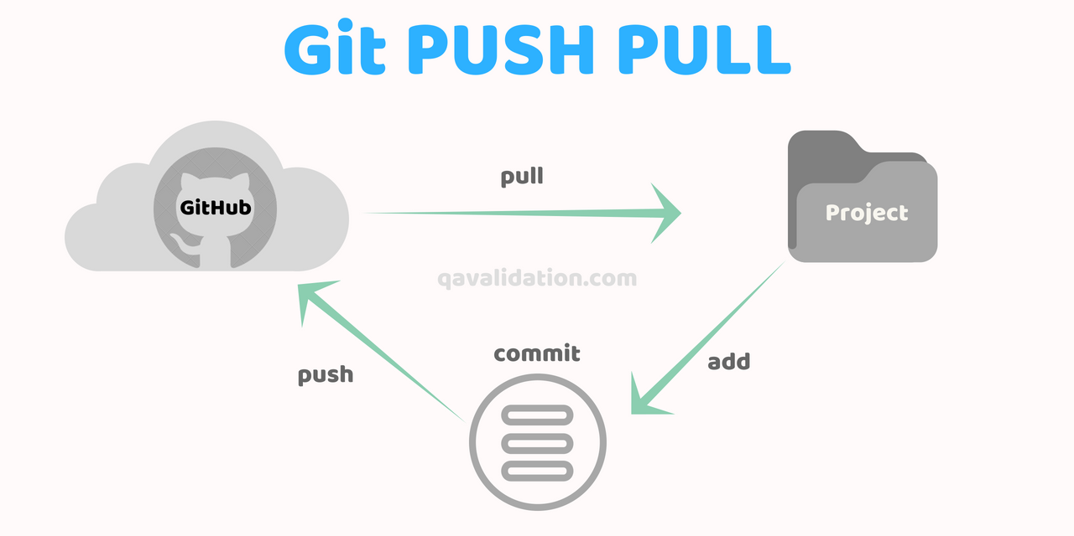
Git and Github: Working Example
Here's a simple example scenario for a data engineer working with a document in a Git repository:
Let's say the data engineer is working on a document named "data_analysis.ipynb" which contains their analysis code. They have cloned the repository onto their local machine and have made some changes to the document.
Git Pull: Before starting any work, the data engineer should ensure they have the latest version of the document from the remote repository. This step will fetch the latest changes from the remote repository (origin) and merge them into the current branch (assuming they are working on the master branch). This step ensures that the engineer's local copy is up-to-date with any changes made by other team members.

Slide 10
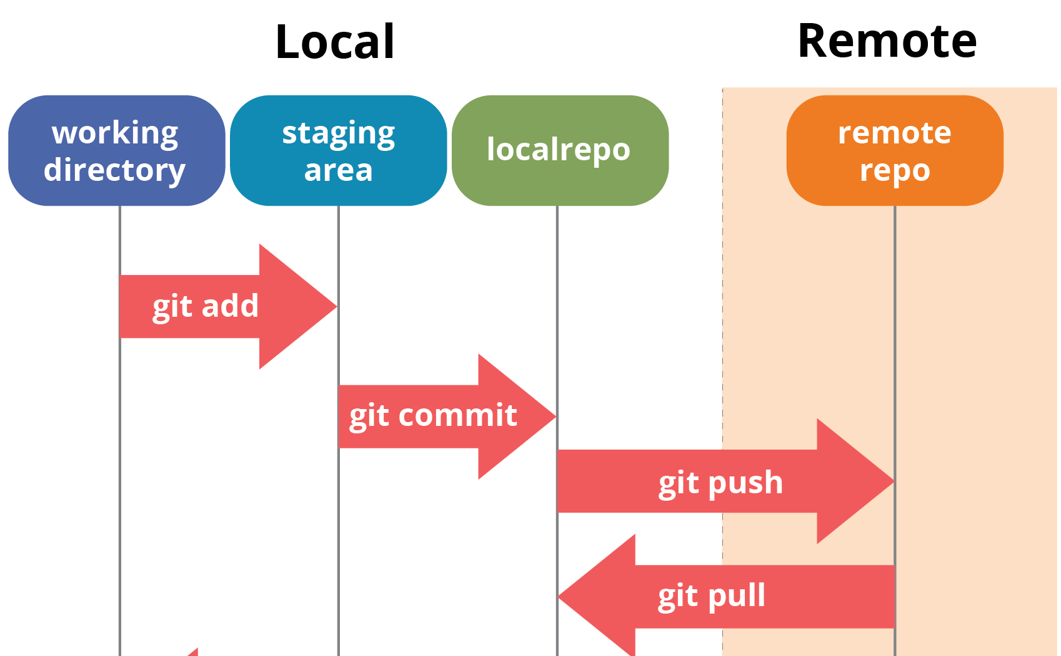
Git and Github: Working Example
Make Changes:
The data engineer then makes changes to the "data_analysis.ipynb" document, adding new analysis or modifying existing code as necessary.
Git Add and Commit:
After making the changes, the engineer needs to stage and commit their changes to the local repository.
This will add the modified document to the staging area and commit it with a descriptive message.

Slide 11
Git and Github: Working Example
Git Push:
Once the changes are committed locally, the engineer needs to push these changes to the remote repository so that other team members can access them.
This step pushes the committed changes from the local master branch to the remote repository (origin). Other team members can now pull these changes into their own local copies of the repository.
By following these steps, the data engineer can effectively collaborate with their team members while working on the document. They pull changes to stay updated, make their modifications, and then push those changes for others to access.

Slide 12
Case Study For Zulo Bank

Slide 13

EXECUTIVE SUMMARY
This case study provides a comprehensive overview of the process involved in database and data warehouse modeling for Zulo Bank, aimed at beginner data engineers.
It covers the foundational aspects of database design, including gathering business requirements, understanding and applying key database principles such as primary and foreign keys, normalization, and denormalization, as well as designing schemas.
The study transitions into data warehouse modeling, focusing on schema transformation, with an emphasis on the practical application of these concepts to solve real-world banking data management challenges.

Slide 14

BUSINESS PROBLEM STATEMENT
Zulo Bank seeks to overhaul its data management system to enhance efficiency, improve data quality, and enable advanced analytics capabilities. The current system is plagued with issues related to data redundancy, inconsistency, and accessibility, hindering real-time decision-making and monthly reporting.
Data engineers are tasked with designing a new system that resolves these issues, ensuring seamless data integration, reporting, and analytics.

Slide 15
TECH STACK
Python: Used for data processing, analysis, and synthetic data generation. Python's extensive libraries (Pandas) facilitate efficient data manipulation for testing and development.
B. SQL (Structured Query Languages)
C. Pgadmin (Postgres Server)

Slide 16
PROJECT SCOPE
Database Design:
Construct a normalized relational database schema for operational use, covering entities such as customers, accounts, transactions, and loans. The design process includes identifying primary and foreign keys, implementing normalization up to the third normal form (3NF), and ensuring data integrity and efficiency.
Data Warehouse Modeling: Develop a data warehouse schema optimized for analysis and reporting. This involves transforming the normalized database schema into a star schema, including fact and dimension tables, to support complex queries and business intelligence needs.
Python Programming: Develop python codes to ingest data, transform it and load it into the PostgreSQL database
Version Control: Carry out good version control practice but using Git Desktop to Push and pull files from our local repository to git repository
This offers a brief overview of the tools and technologies involved in the Zulo Bank case study, alongside a concise description of the project's scope, from database and data warehouse design to documentation.

Slide 17
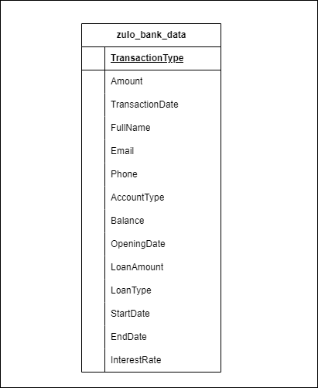
DATASET
You can access the dataset here ⇒ Link

Slide 18
DATABASE MODELLING
1NF
2NF

Slide 19
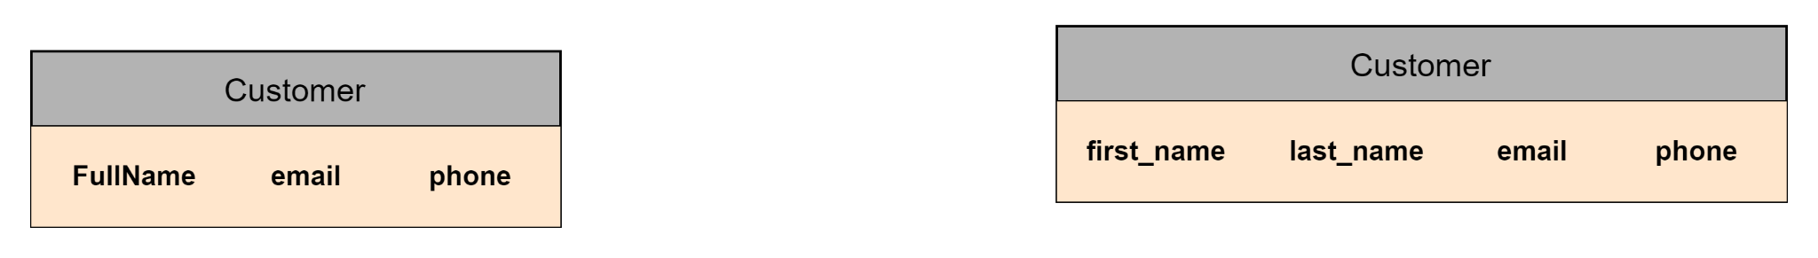
DATABASE MODELLING
Denormalized Table to 1st Normal Form

Slide 20
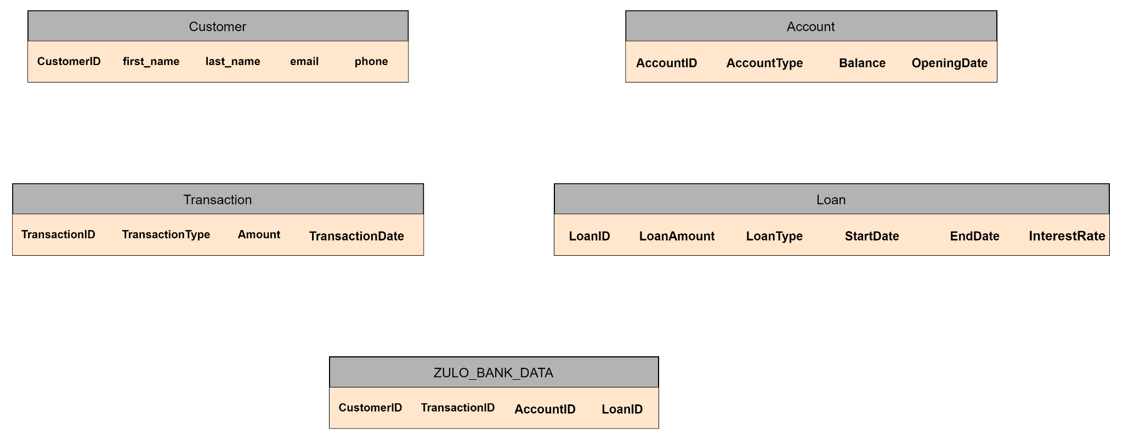
DATABASE MODELLING
PK
PK
PK
PK
1st Normal Form to 2nd Normal Form
Note: We added primary keys to the Customer tables, Transaction tables, Account tables and Loan tables.

Slide 21
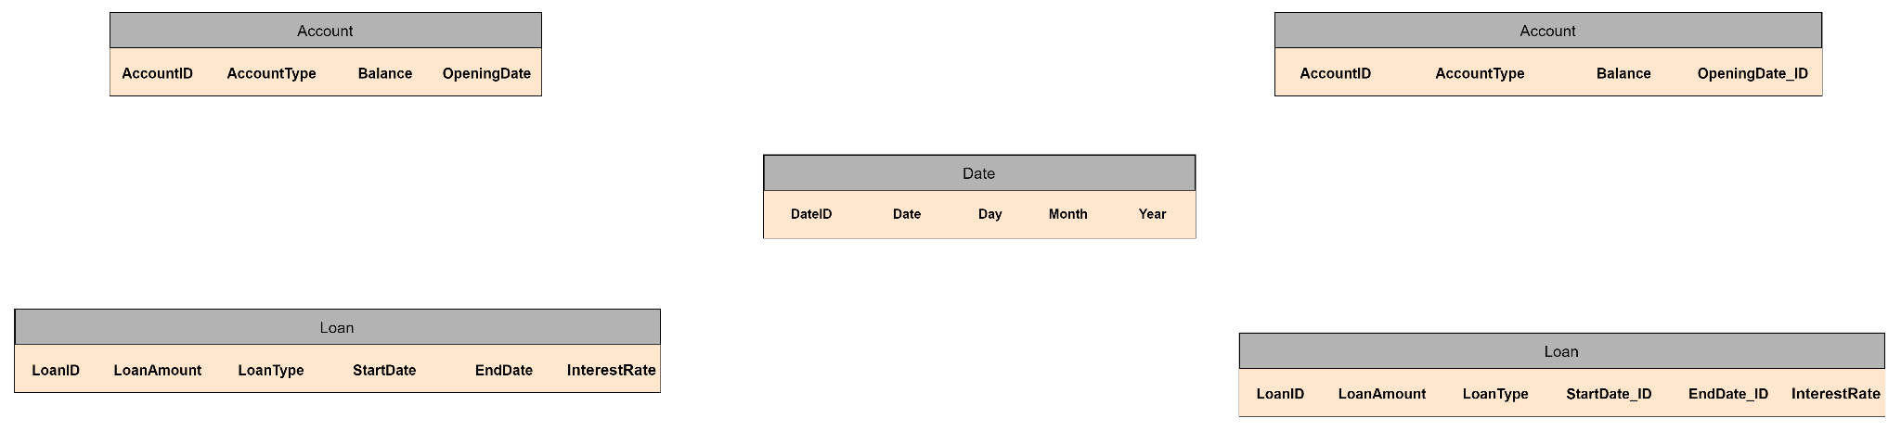
DATABASE MODELLING
2nd Normal Form to 3rd Normal Form

Slide 22
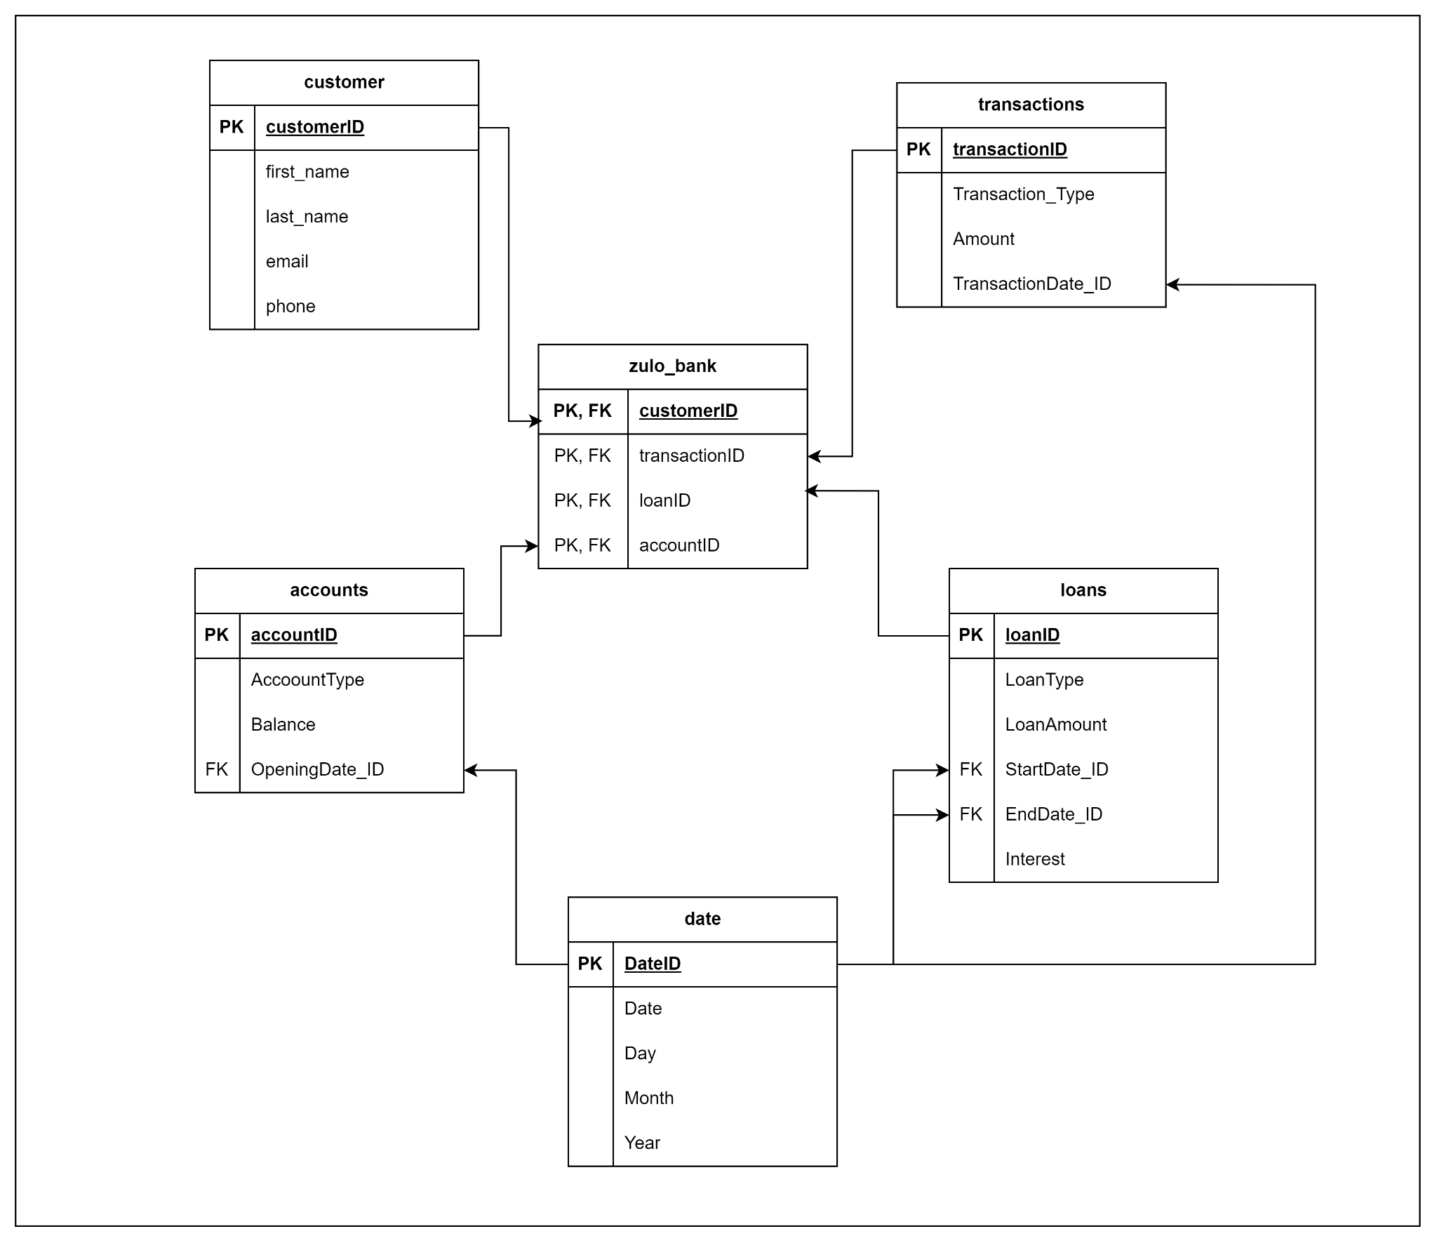
DATABASE MODELLING
2nd Normal Form to 3rd Normal Form

Slide 23
DATA WAREHOUSE MODELLING
Fact Table Consideration:
Transactions Fact Table: Could include TransactionID, AccountID (as a foreign key to the Account dimension), date_id (as a foreign key to the Date dimension), and measurable metrics like Amount.
Loans Fact Table: Could include LoanID, CustomerID (as a foreign key to the Customer dimension), start_date_id, end_date_id (as foreign keys to the Date dimension), and metrics like LoanAmount and InterestRate.
2nd Normal Form to 3rd Normal Form

Slide 24
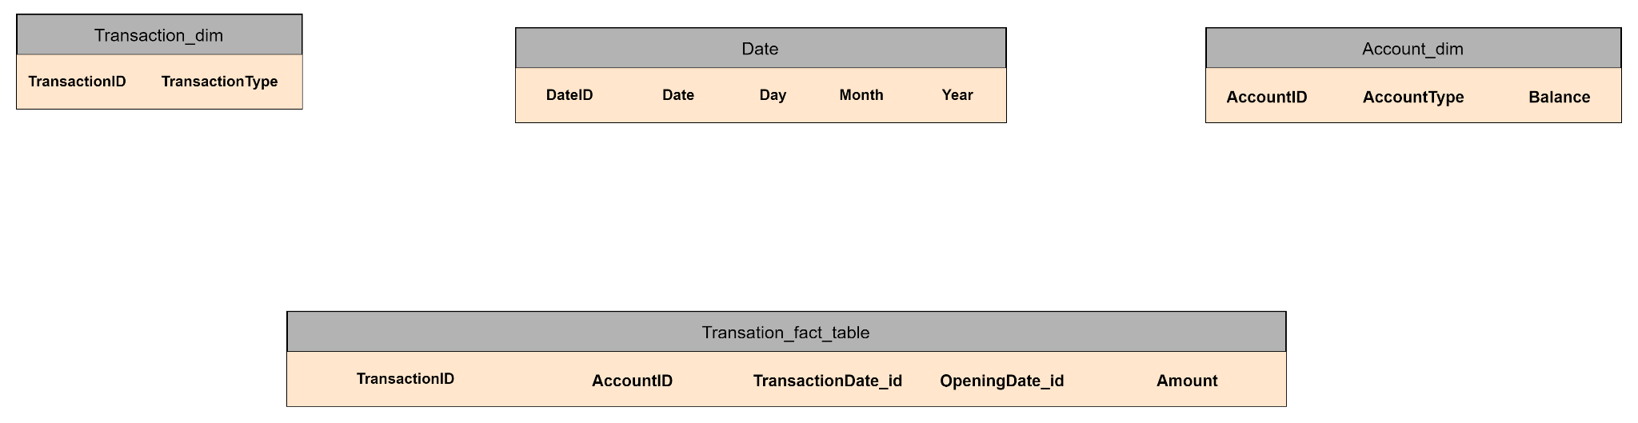
DATA WAREHOUSE MODELLING
Transactions Fact Table
2nd Normal Form to 3rd Normal Form

Slide 25
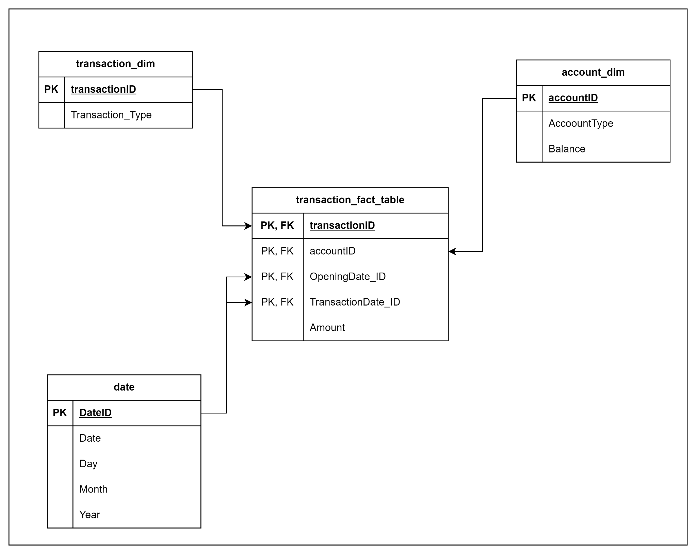
DATA WAREHOUSE MODELLING
2nd Normal Form to 3rd Normal Form

Slide 26
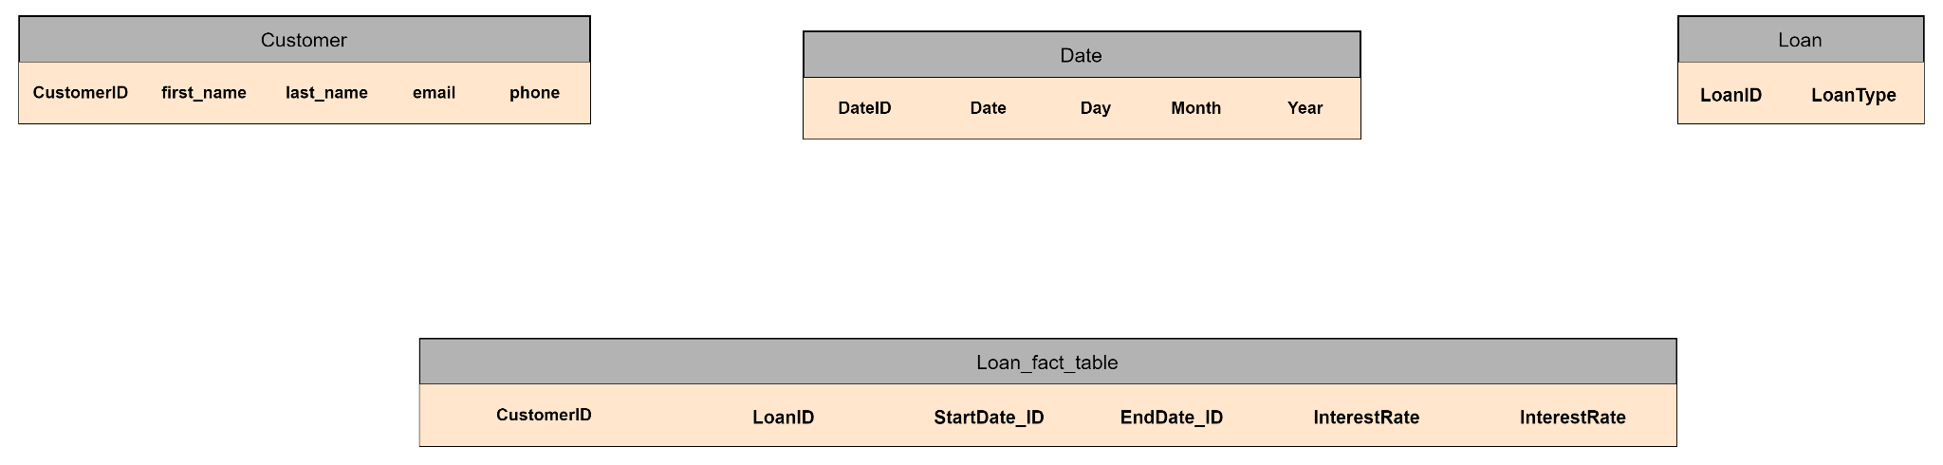
DATA WAREHOUSE MODELLING
Loans Fact Table
2nd Normal Form to 3rd Normal Form

Slide 27
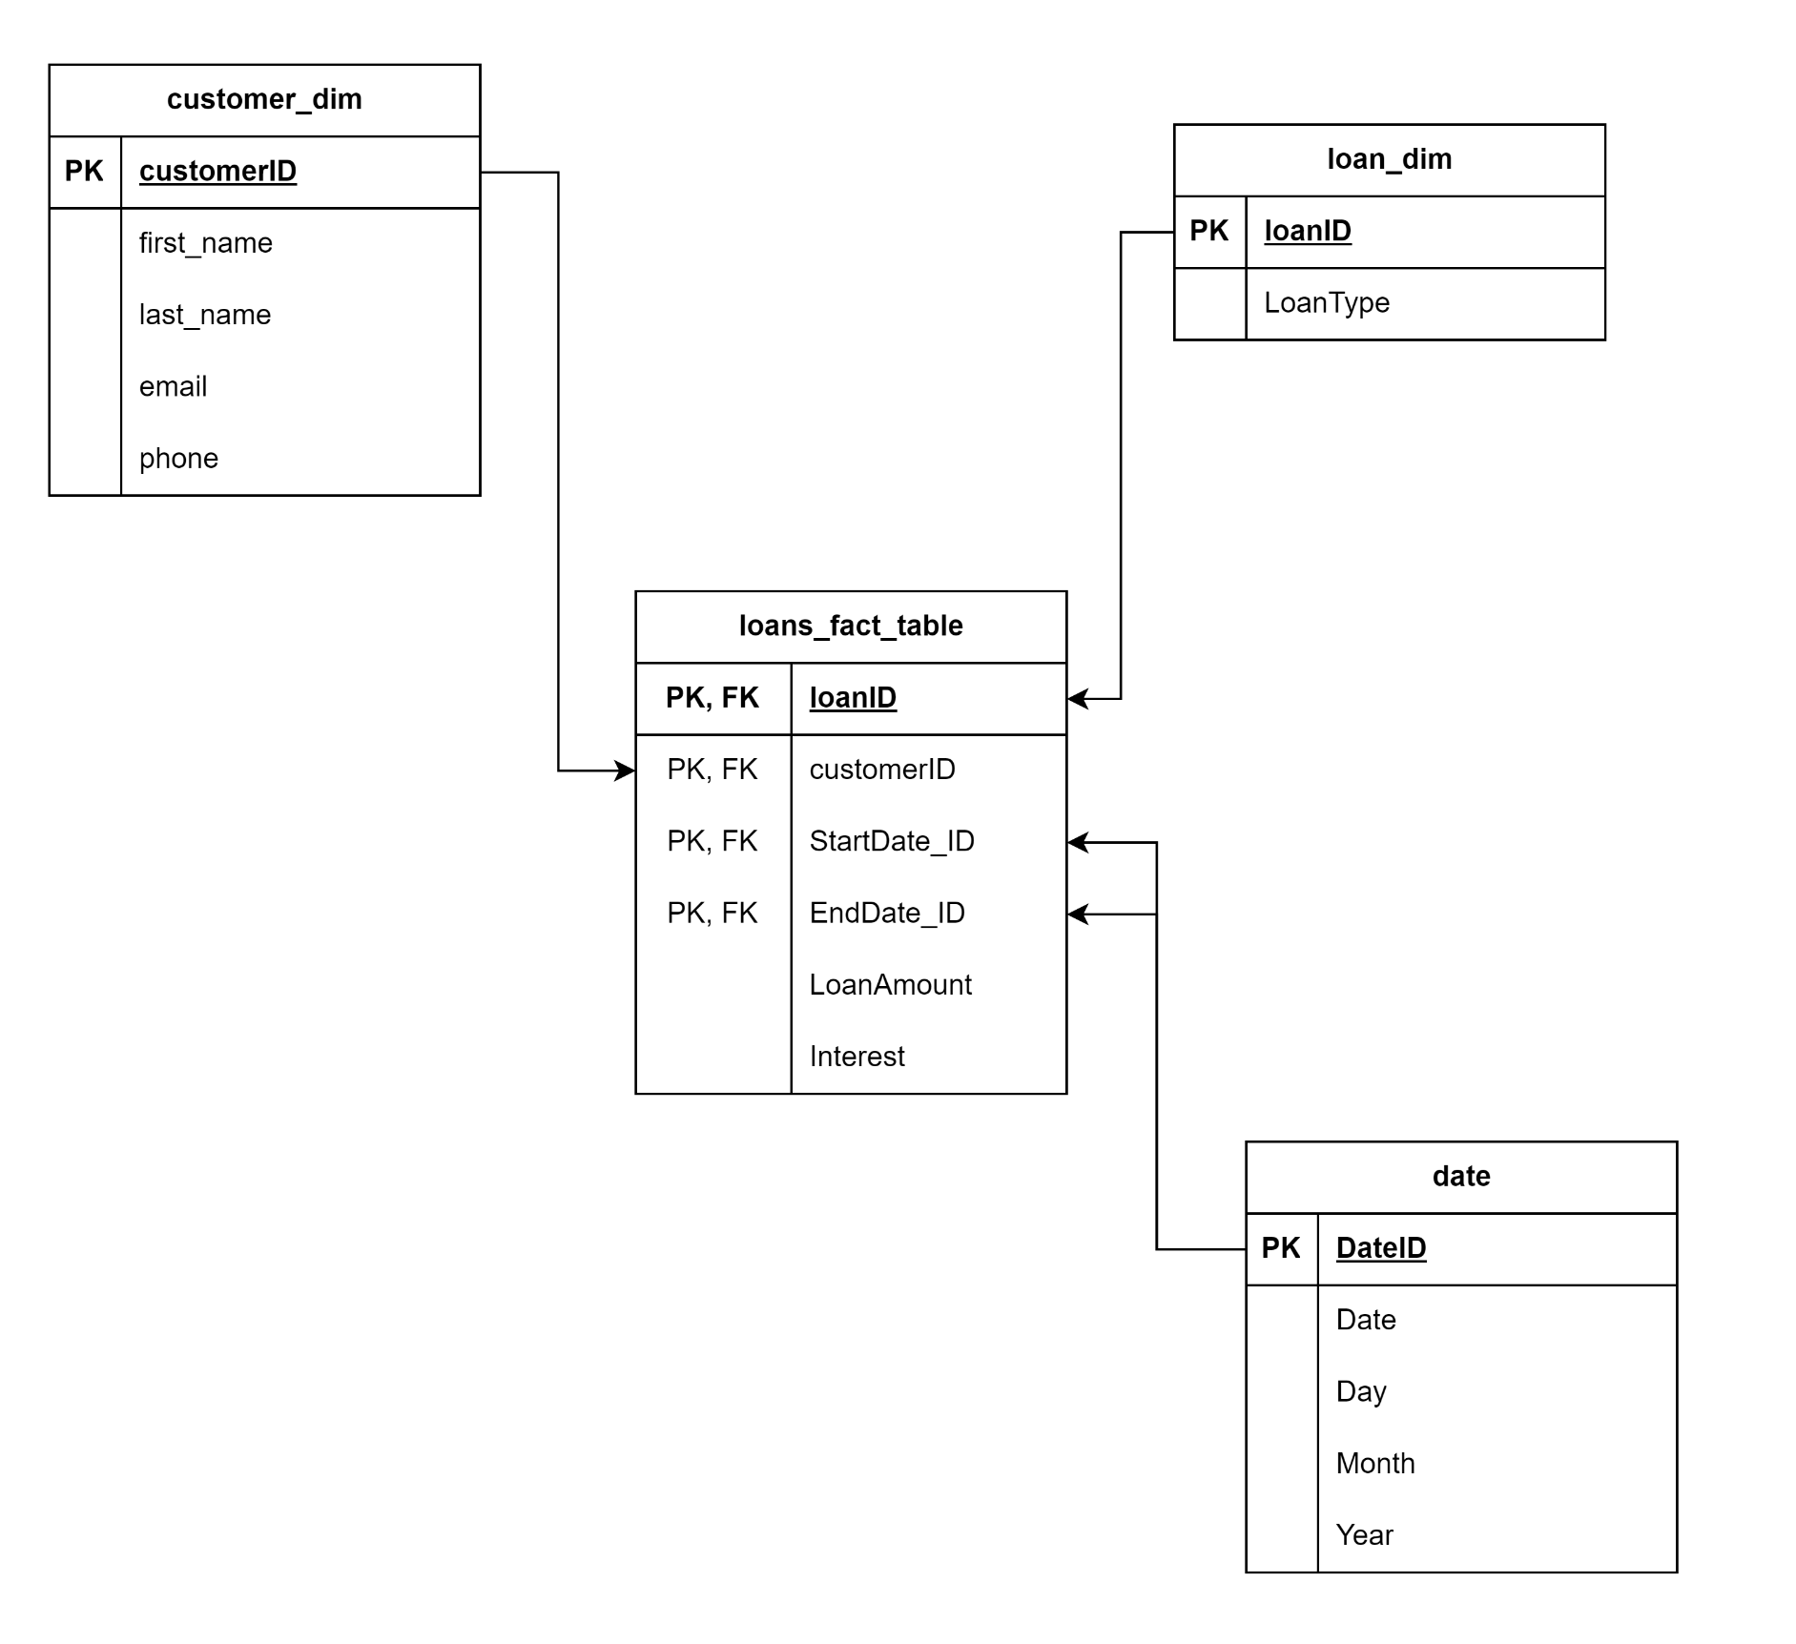
DATA WAREHOUSE MODELLING
2nd Normal Form to 3rd Normal Form

Slide 28
Now We Proceed To Coding!!!
Happy Coding!!!

Slide 29


GOODLUCK

